Slide 1
Lecture Plan
Review
Memory Management
Processor Management
Device Management
Storage Management

Slide 2
Classes of Computers
Supercomputers
Mainframes
Minicomputers
Microcomputers
Smartphones

Slide 3
PC Hardware
Case
Power Supply
Cooling Systems
Motherboard
  Processor socket
  Memory slots
  Hard drive connectors
  Power connectors
  Expansion slots
  I/O ports

Slide 4
PC Hardware
Expansion Cards
Storage Devices
Communication Devices
  Modem
  NIC
  Wireless Adapter
Peripherals

Slide 5
PC Hardware
Microprocessor (CPU)
  Arithmetic & logical operations
  Register: small amount of memory
Memory
  RAM
  ROM
Bus
  Transfers data between components

Slide 6
PC Hardware
Disk Drive Controllers
  Manage data transfer between the bus and disk drive
  ATA, SATA, SCSI
BIOS
  Supports PC during start-up
  Has functions to control keyboard, output text, reads from disk drives
  Option to enter BIOS setup program when PC starts

Slide 7
PC Hardware
Floppy disks
  portable, inexpensive, slow, low capacity
Tape drives
  slow, high capacity, sequential access
Optical drives
  encode data with lasers, high capacity

Slide 8
PC Hardware
Hard drives
  Fast, high capacity, expensive
  Cabled to various controllers: ATA, SATA, SCSI
  May be connected externally to USB, Firewire, or eSATA ports
USB drives
  portable, use flash or external hard drives

Slide 9
Boot Process
The procedure by which the computer starts and loads the OS.
  1. Power supply
  2. BIOS
  3. POST
  4. Option ROMs
  5. Startup Screen

Slide 10
Boot Process
  6. Plug & Play
  7. Look for boot device
  8. Load boot sector / MBR
  9. Run boot loader
  10. Load operating system

Slide 11
What does an OS do?
Memory management
Processor management
Device management
Storage management
User interface

Slide 12
Disk Operating System (DOS)
Term most often associated with
MS-DOS
Accessible through a command-line interface (CLI)
First IBM PC shipped with up to 256 KB of RAM and a 5 Mhz CPU

Slide 13
Memory Management
Allocation of memory based on program need
Real mode: first 1 MB of memory (16-bit)
Protected mode: up to 4 GB (32-bit)
Virtual memory gives appearance of more memory than is actually installed

Slide 14
DOS
Memory in DOS
  Real mode: originally 640 KB of conventional memory
  Upper memory raised total memory to 1 MB
  Himem.sys memory manager handles region above 640 KB (upper)

Slide 15
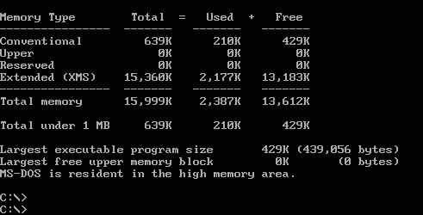
DOS
Two add-on cards supported enhanced memory
  XMS (Extended Memory Specification)
  EMS (Expanded Memory Specification)
Emm386.exe extended memory manager controlled memory above 1 MB

Slide 16
Protected Mode
Protected mode: an improvement over real mode
  Introduced in Intel 286 CPU
  Addresses memory > 1024 KB, uses 32-bit data path
  Allows for virtual memory, multitasking, and restricted memory access
  Windows XP and Linux operate in protected mode

Slide 17
Virtual Memory
  The problem: The amount of space required for all running processes can often exceed the maximum size of the physical memory (RAM).

Slide 18
Virtual Memory
The solution:
  Some of the instructions and data can be stored in slower, but much larger, secondary storage (usually a hard drive).
  This creates a new problem because process execution relies upon a single, continuous memory space.

Slide 19
Virtual Memory
Virtual memory is a memory management technique, by which blocks of non-contiguous memory are presented to processes as a single, continuous memory address space.

Slide 20
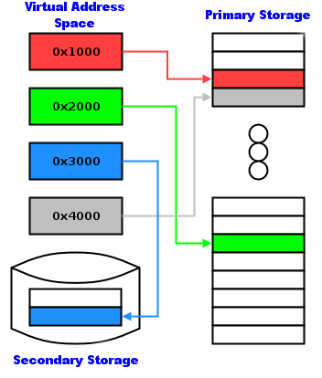
Virtual Memory
    A virtual address space is provided which is contiguous
    Virtual addresses map to real storage addresses
    When an address which resides in secondary storage is requested, an interrupt occurs
    The appropriate chunk of memory in secondary storage is swapped with a chunk of memory in primary storage.
    This is called paging.

Slide 21

Alan Turing
English mathematician, logician and cryptographer
Worked on breaking German naval codes during WWII
Considered father of modern computer science
  Turing machine
  Turing test

Slide 22
Processor Management
Original DOS was
single-tasking
Modern multitasking operating systems run multiple programs at once
Each program
consists of one or
more processes
Simultaneous
execution is actually rapid switching

Slide 23
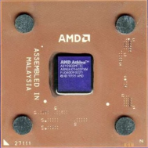

Execution
      The CPU reads an instruction from RAM.
      On the basis of that instruction, the CPU might jump to a different location in RAM, read data from RAM, write data to RAM, perform a mathematical operation, or some combination of these.
      Repeat. This is an approximation of a Turing machine.
A. Read
Instruction
B.Jump to
new location / read data / write data / etc...
C. Repeat

Slide 24

Process
A process is a running instance of a program (software), including the instructions and all associated data. The process is stored in RAM and is manipulated by the CPU.
CPU
RAM
Process

Slide 25
Multitasking
  Multitasking is the ability of an operating system to create the illusion that multiple programs are running simultaneously.
  The OS uses scheduling to determine which process should be allowed to run and for how long.
  Interrupts are used to control process execution.

Slide 26
Single-user vs. multi-user
  Single-user operating systems can only support one user at a time.
    DOS is an example
    Single-user operating systems generally cannot multitask
  All modern operating systems are multi-user and can support many different people using the operating system at the same time.
    For example, web servers running Windows or Linux support many users.
    Multi-user operating systems must also, by definition, be multi-tasking.
  NOTE: Most multi-user operating systems can also be booted in single-user mode.

Slide 27

Interrupt
An interrupt causes the processor to save its state of execution via a context switch, and begin execution of an interrupt handler.
B. Context
switch – context
is saved to RAM
A. Interrupt
occurs
C. Execution of
interrupt handler
begins
RAM
Process
Interrupt Handler

Slide 28
Types of interrupts
  A hardware interrupt is generated externally by hardware, such as a system timer, disk drive, power switch, network interface, etc.
  A software interrupt is generated inside the CPU when it executes certain instructions

Slide 29
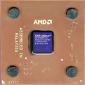
Multiprocessing
Multiprocessing means the use of two or more CPUs in a single computer.
  Each CPU can execute a separate process.
CPU #1
RAM
CPU #2

Slide 30
Processor Symmetry
In a multiprocessing system, all CPUs may be equal, or some may be reserved for special purposes.
  Symmetric multiprocessing is when two or more identical CPUs share the load equally.
  Asymmetric multiprocessing assigns certain processes (ie. the OS) to certain CPUs.

Slide 31
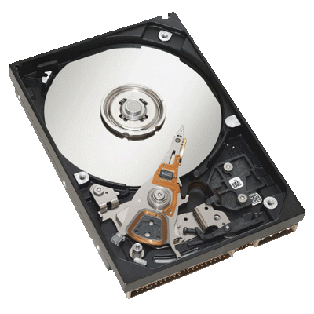
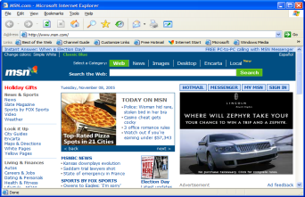
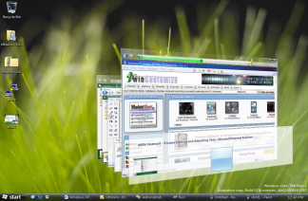
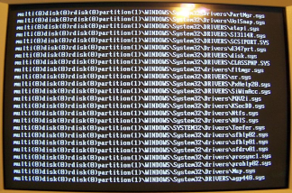
Device Management
Device drivers connect the OS to hardware
Application Software
Operating System
Device Driver
Hardware Device

Slide 32
Device Driver
  A device driver typically includes:
    An interface for communicating with the device
    Providing commands to and/or receiving data from the device
    Providing an interface to the operating system and application software (often via hardware interrupts and interrupt handlers).

Slide 33
Windows XP Device Drivers
Example: Windows XP implementation of printer drive
  Application provides graphical device interface (GDI)
  Driver connects GDI to a device, such as a printer
  Request flow: application->GDI->driver->device

Slide 34
Linux Device Drivers
Example: Linux printer driver
  Application produces PostScript (page description)
  Flow passes to device driver
  Ghostscript converts PostScript to device commands

Slide 35
Print Spooler
Spooler: manages queues of print jobs
  Spool (simultaneous peripheral operations online)

Slide 36
Storage Management
Partition management
File systems
File maintenance
Security
Quota management

Slide 37
DOS VMware Demo
fdisk (partitioning)
format (formatting)

Slide 38
XP VMware demo
Disk Management utility (partitioning)
Windows Explorer (formatting)

Slide 39
Linux Demo
fdisk (partitioning)
mke2fs (formatting)

Slide 40
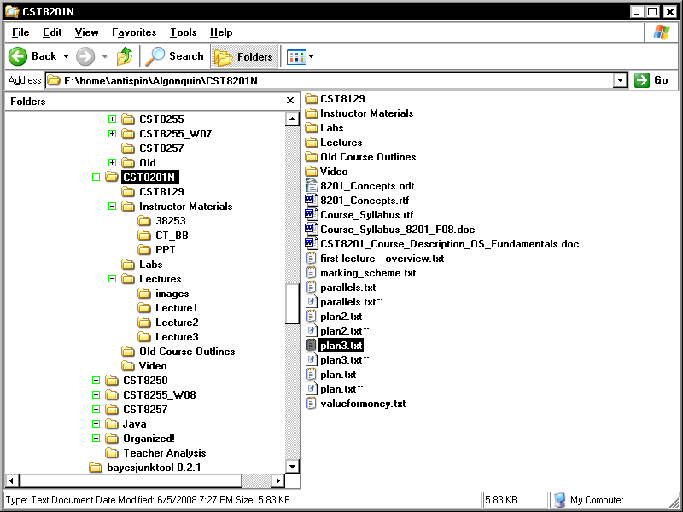
File maintenance
Manage files & folders
  Delete
  Copy
  Move
  Rename
  View

Slide 41
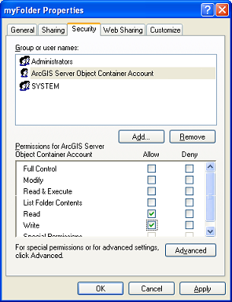
Security
Control access to sensitive files
File permissions
  Hidden files
  Read-only files
  ACLs (Access Control Lists)

Slide 42
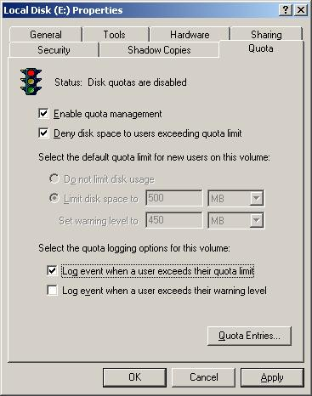
Quota Management
Limits overuse of disk space by individual users

